Slide 1

^{The language we use:} 10 minutes on introspection, feedback and self-awareness
Chris Unwin

Slide 2


Slide 3

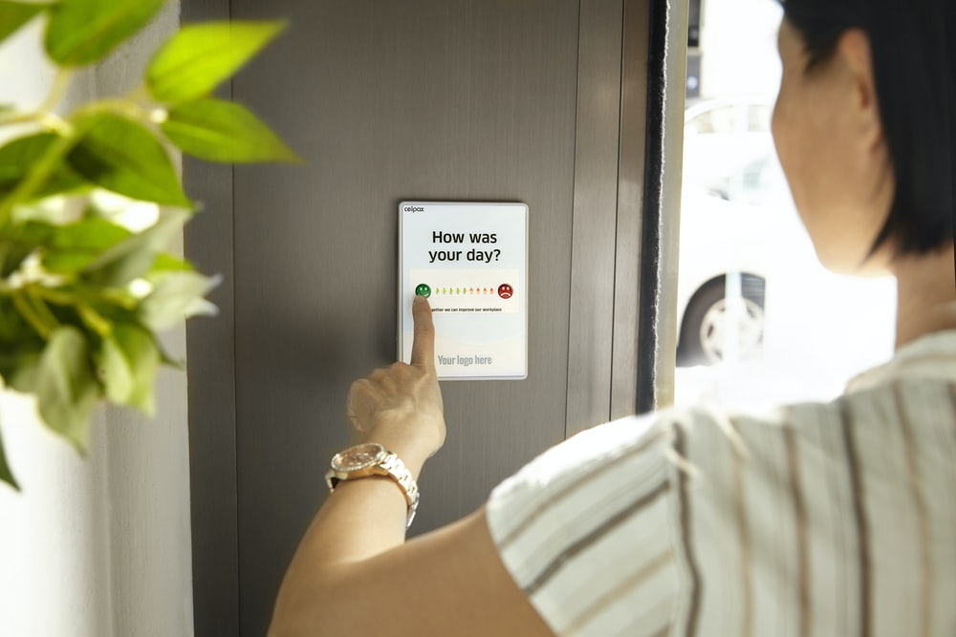

Our Thoughts
Notes:
Images:
https://images.unsplash.com/photo-1508591360875-10163ed98c8e?ixlib=rb-1.2.1&ixid=eyJhcHBfaWQiOjEyMDd9&auto=format&fit=crop&w=675&q=80
https://images.unsplash.com/photo-1589187775328-882e91b3db4f?ixlib=rb-1.2.1&ixid=eyJhcHBfaWQiOjEyMDd9&auto=format&fit=crop&w=1350&q=80
https://images.unsplash.com/photo-1446511437394-36cdff3ae1b3?ixlib=rb-1.2.1&ixid=eyJhcHBfaWQiOjEyMDd9&auto=format&fit=crop&w=1350&q=80

Slide 4

“Good”
Notes:
Images:
https://images.unsplash.com/photo-1489710437720-ebb67ec84dd2?ixlib=rb-1.2.1&ixid=eyJhcHBfaWQiOjEyMDd9&auto=format&fit=crop&w=1350&q=80

Slide 5
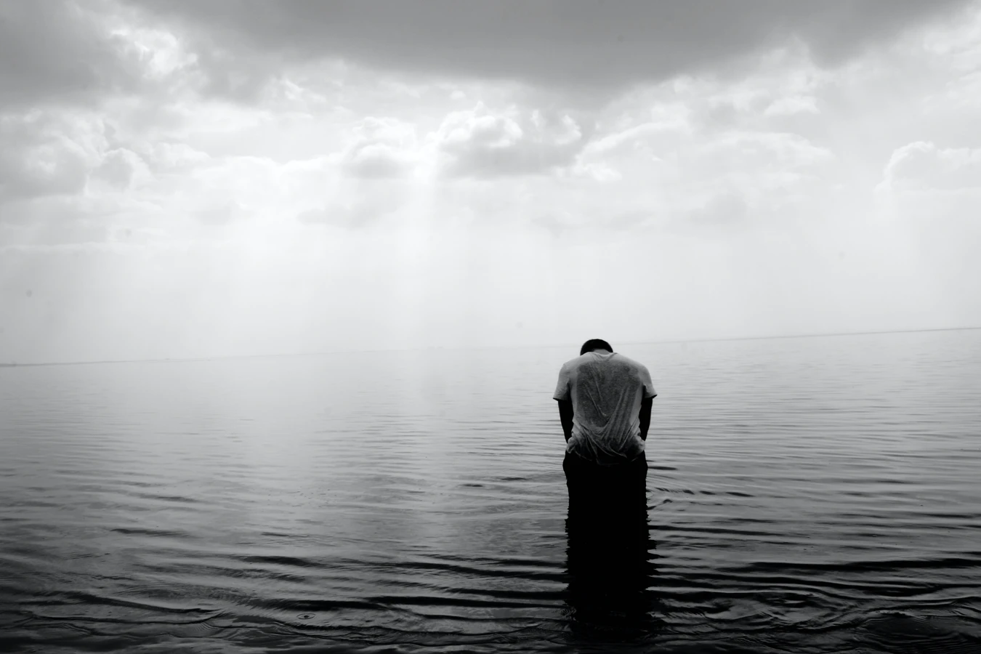
“Bad”
Notes:
Images:
https://images.unsplash.com/reserve/dPfjQTyJSJ2LpM7D9Yr0_Photo%2015-02-2014.jpg?ixlib=rb-1.2.1&ixid=eyJhcHBfaWQiOjEyMDd9&auto=format&fit=crop&w=1350&q=80

Slide 6
“Meh”

Slide 7
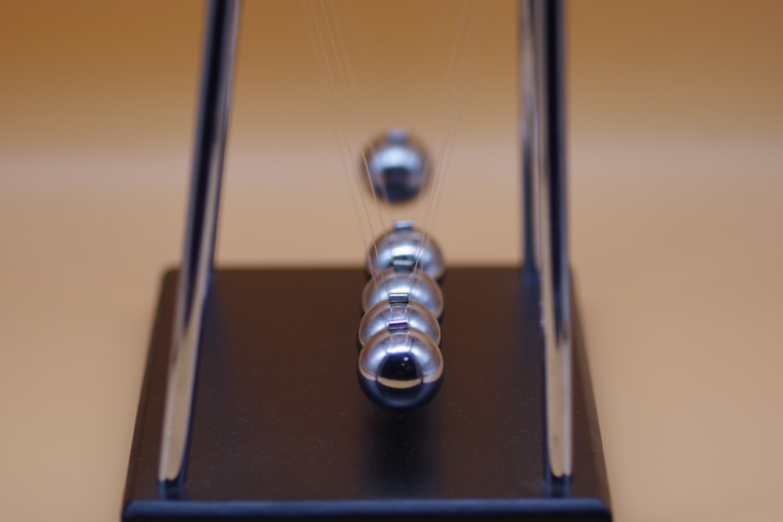
Our thoughts have a profound impact on who we are…
…But. We are not the product of our thoughts.
Notes:
Image: https://images.unsplash.com/photo-1588720516255-fc99581c9716?ixlib=rb-1.2.1&ixid=eyJhcHBfaWQiOjEyMDd9&auto=format&fit=crop&w=1350&q=80

Slide 8

#1: Introspection
You are the product of how you act
Your thoughts are the product of your experiences - they are transient
You can choose how to experience those thoughts and emotions
Notes:
Image: https://images.unsplash.com/photo-1531956759688-e71cc2586e34?ixlib=rb-1.2.1&ixid=eyJhcHBfaWQiOjEyMDd9&auto=format&fit=crop&w=634&q=80
Introspection: the process of observing the operations of one’s own mind

Slide 9




Observe.
Acknowledge.
Adjust.
Notes:
Image: https://images.unsplash.com/photo-1543210089-238ae1f26b32?ixlib=rb-1.2.1&ixid=eyJhcHBfaWQiOjEyMDd9&auto=format&fit=crop&w=634&q=80

Slide 10

#2: Self Awareness
Self awareness is not just knowing where you are and what you’re doing
Self awareness is about Monitoring
Understanding our stress, worries, emotions and beliefs
Notes:
Image: https://images.unsplash.com/photo-1531956759688-e71cc2586e34?ixlib=rb-1.2.1&ixid=eyJhcHBfaWQiOjEyMDd9&auto=format&fit=crop&w=634&q=80

Slide 11

Embrace Vulnerability
and Honesty.
Notes:
Image: https://images.unsplash.com/photo-1571266882932-33f7c046a0c9?ixlib=rb-1.2.1&ixid=eyJhcHBfaWQiOjEyMDd9&auto=format&fit=crop&w=634&q=80
Don’t let shame control you.

Slide 12
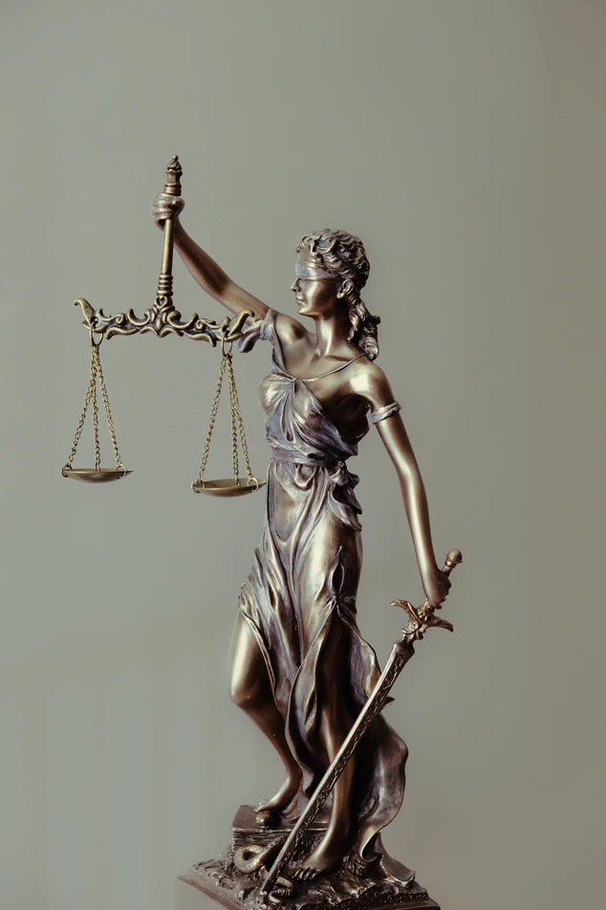
#3: Feedback
We are afraid of judgement
When we speak to or about ourselves we enforce our own judgement
We only self-reflect when things go wrong
Notes:
Image: https://images.unsplash.com/photo-1589578527966-fdac0f44566c?ixlib=rb-1.2.1&ixid=eyJhcHBfaWQiOjEyMDd9&auto=format&fit=crop&w=634&q=80

Slide 13

I’ll never be able to do this / I can’t do this
Change up your language.
I will be able to do this, who can I ask for help?
Notes:
Image: https://images.unsplash.com/photo-1571498664957-fde285d79857?ixlib=rb-1.2.1&ixid=eyJhcHBfaWQiOjEyMDd9&auto=format&fit=crop&w=564&q=80

Slide 14

Stop comparing yourself to others.
Everyone is different.
Everyone is unique.
Everyone has something to offer.
Notes:
Image: https://images.unsplash.com/photo-1571266882932-33f7c046a0c9?ixlib=rb-1.2.1&ixid=eyJhcHBfaWQiOjEyMDd9&auto=format&fit=crop&w=634&q=80

Slide 15

Conclusions
You are the product of your actions, not your thoughts.
Check in with yourself when times are good, not just bad.
If you need help, reach out.
Notes:
Image Source: https://images.unsplash.com/photo-1578357078586-491adf1aa5ba?ixlib=rb-1.2.1&ixid=eyJhcHBfaWQiOjEyMDd9&auto=format&fit=crop&w=700&q=80

Slide 16
Reach out where?
Every country will have different services
Speak to employers about employee assistance programs
Global Mental Health Support: https://unitedgmh.org/mental-health-support
Notes:
Image Source: https://images.unsplash.com/photo-1578357078586-491adf1aa5ba?ixlib=rb-1.2.1&ixid=eyJhcHBfaWQiOjEyMDd9&auto=format&fit=crop&w=700&q=80

Slide 17

Resources
Brene Brown on Vulnerability (YouTube)
Stop Calling Yourself An Idiot (Blog)
Meditate in a Moment (YouTube)
Mindfulness Made Easy (Podcast)
Notes:
Image: https://images.unsplash.com/photo-1589578527966-fdac0f44566c?ixlib=rb-1.2.1&ixid=eyJhcHBfaWQiOjEyMDd9&auto=format&fit=crop&w=634&q=80

Slide 18

Notes:
Image: https://images.unsplash.com/photo-1502355984-b735cb2550ce?ixlib=rb-1.2.1&ixid=eyJhcHBfaWQiOjEyMDd9&auto=format&fit=crop&w=1350&q=80

